Slide 1
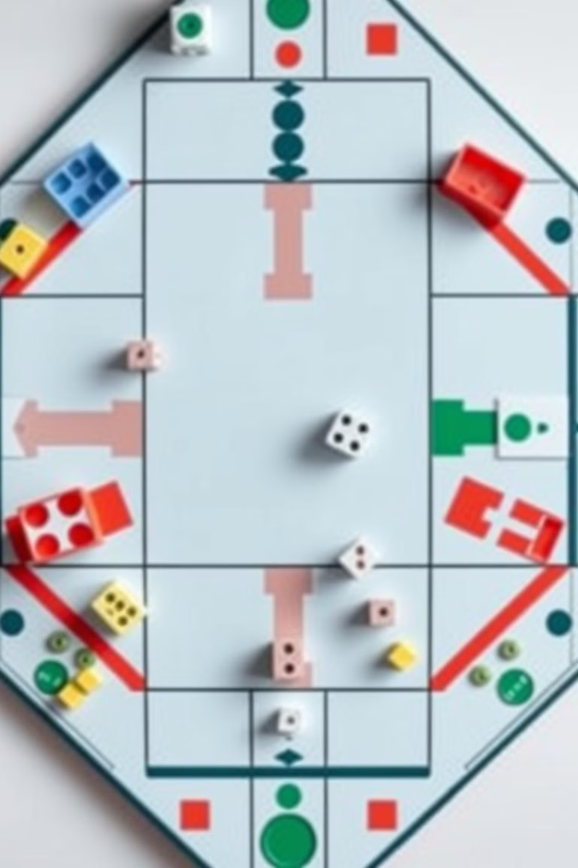
" Designing an Intelligent Agent for Ludo Game using Reinforcement Learning "
This project focuses on creating a smart Ludo agent. Reinforcement Learning is used for intelligent game-playing. Q-learning and Deep Q-learning algorithms are applied. The goal is for the agent to learn strategies and play Ludo proficiently.

Slide 2

Problem Definition - Challenges in Ludo
Ludo presents AI with various complexities. State space representation poses a significant challenge. The stochastic nature of dice rolls adds uncertainty. Delayed rewards and long-term strategy make learning difficult.

Slide 3
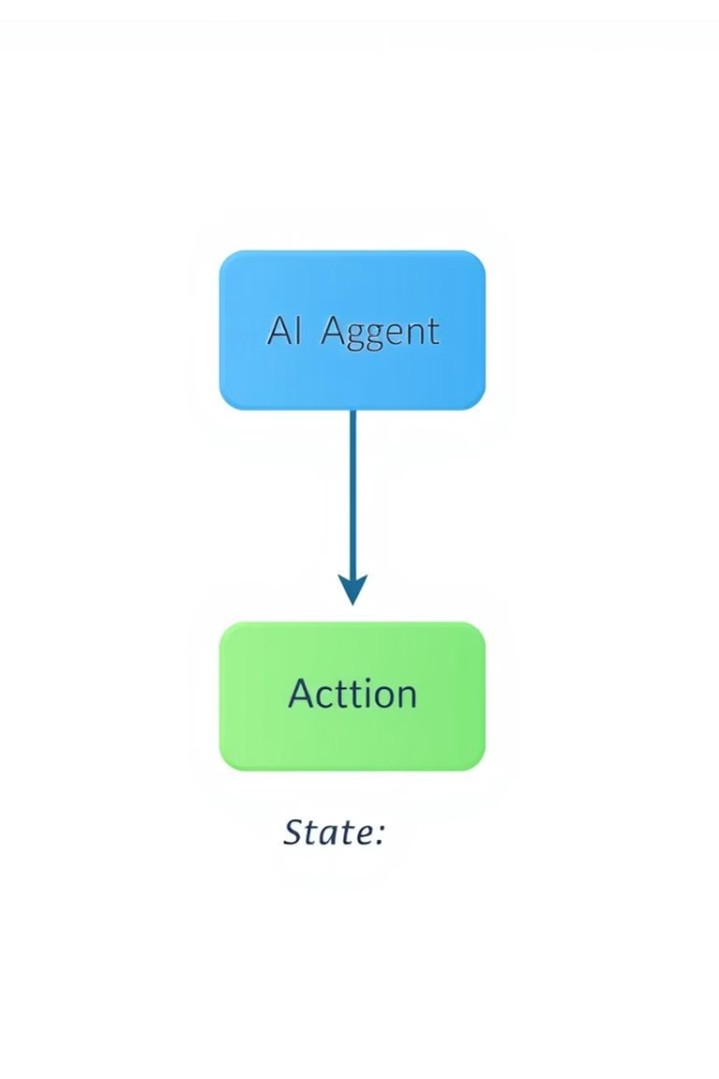
Reinforcement Learning Fundamentals
Reinforcement Learning centers on agent interaction with an environment. Agents learn by taking actions and receiving rewards. Key terms include states, actions, rewards, and policies. Markov Decision Process (MDP) provides a framework.

Slide 4
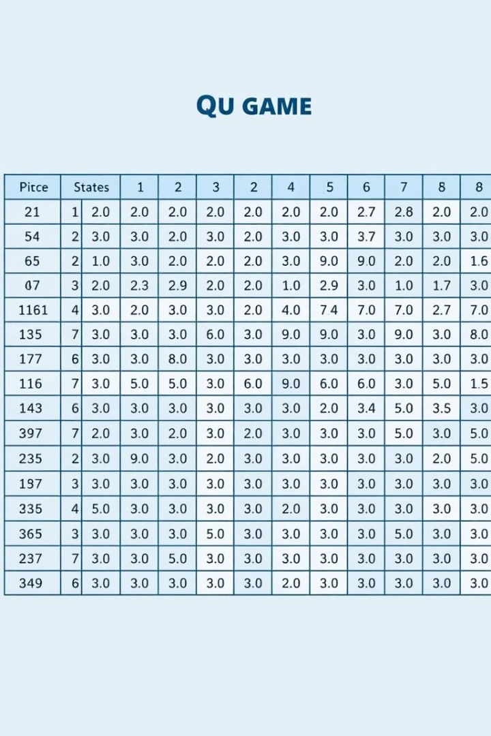
Q-learning Implementation
Q-learning algorithm learns optimal actions through experience. A Q-table stores Q-values for state-action pairs in Ludo. The Q-learning update rule refines these Q-values. Exploration-exploitation balance ensures effective learning.

Slide 5
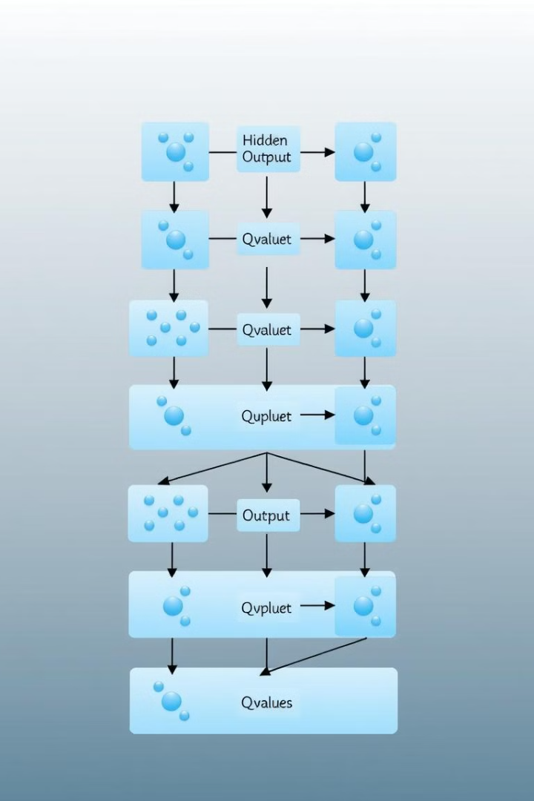
Deep Q-learning Implementation
Deep Q-learning (DQN) utilizes neural networks. Neural networks approximate the Q-function for complex state spaces. Experience replay enhances learning stability. Target networks improve the training process.

Slide 6

Experimental Setup and Evaluation Metrics
The experimental setup involves training and testing environments. Win rate and average score are key evaluation metrics. Hyperparameter tuning optimizes the training process. Performance is compared with baseline strategies.

Slide 7
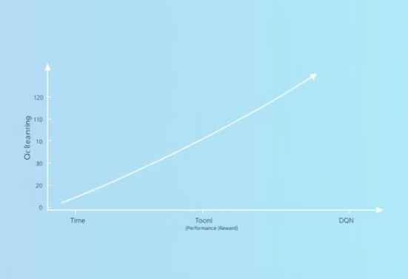
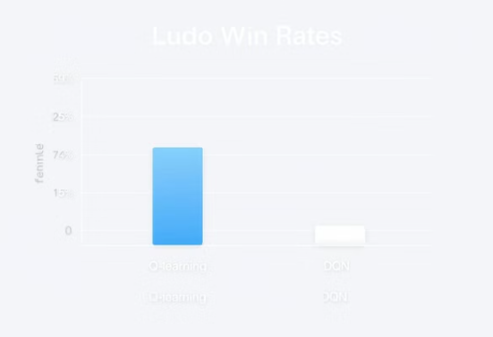
Results and Analysis
Q-learning and DQN experiment results are presented. DQN generally outperforms Q-learning. Learning curves illustrate performance improvement. Strengths and weaknesses of each approach are discussed.

Slide 8
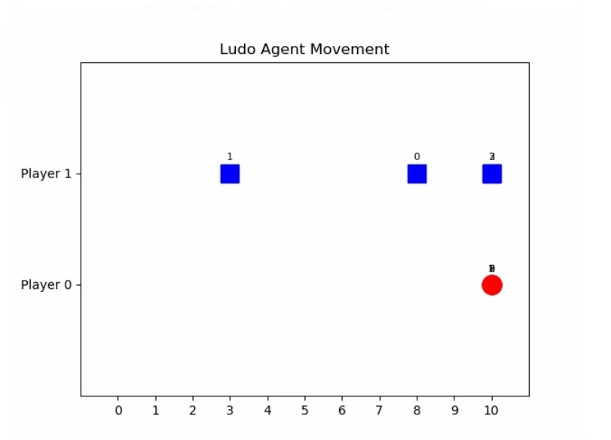
Live Demo
A live demo in a Ludo game is a real-time showcase where the game is played in front of an audience (or users) to demonstrate how it works. It usually shows:
The game board and pieces.
How players take turns.
Rules being applied (e.g., dice rolls, movement, capturing).
AI behavior if it's a single-player or AI-vs-AI demo.
Real-time updates and interactions.
It's useful for testing, showing features, or presenting the game in a project or during development.

Slide 9
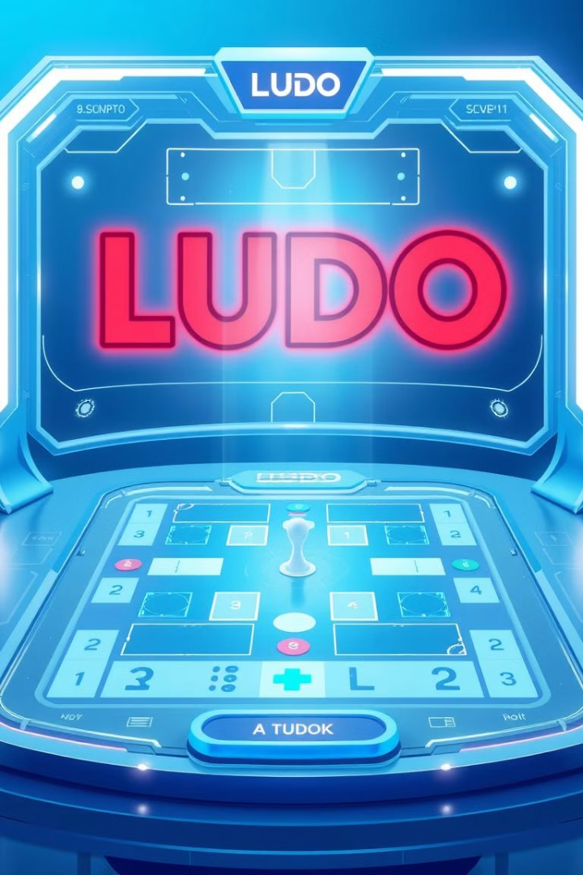
The project showcases the effectiveness of RL for Ludo. Future research could explore other RL algorithms. Improving the agent's strategy and adaptability. Implementing multi-agent learning scenarios offers potential.

